Slide 1
STATISTICS WITH DATA SCIENCE- MINI PROJECT
SUICIDE RATE OVERVIEW
TEAM MEMBER DETAILS:
1. Michelle Mary Varghese - PES1UG19CS271 3. Parimala V- PES1UG19CS324
2. Pradnya Sanjeev - PES1UG19CS331 4. Navya Eedula – PES1UG19CS293

Slide 2
INTRODUCTION
Close to 800 000 people die due to suicide every year, which is one person every 40 seconds.
Suicide is the second leading cause of death among 15-24 year olds globally.
Depression and stress are the leading causes of suicide.
The Human Development Index (HDI) is used to measure a country's overall achievement in its social and economic dimensions, which are based on the health of people, their level of education attainment and their standard of living.
The Gross Development Product (GDP) is the standard measure of the value added created through the production of goods and services in a country during a certain period.

Slide 3
FEATURES OF OUR DATASET
This dataset consists of the data regarding suicide trends in 40 countries. It has 11520 rows.
It has 11 columns – country, year, sex, age, number of suicides, population, suicides per 100k, HDI for year, GDP for year, GDP per capita and generation.
Before cleaning the dataset, there were about 4% NULL values, concentrated in the column HDI for year.

Slide 4
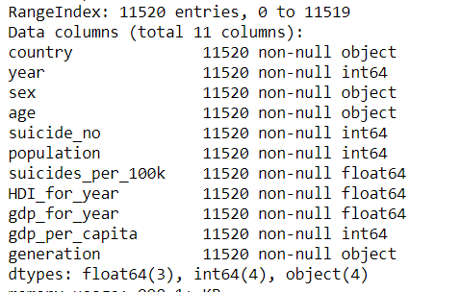
Categorical variables: age,sex,country,generation
Discrete numerical:
year, suicide_no , population,
Continuous variables:
HDI_for_year, suicides_per_100k, gdp_per_capita, gdp_per_year

Slide 5
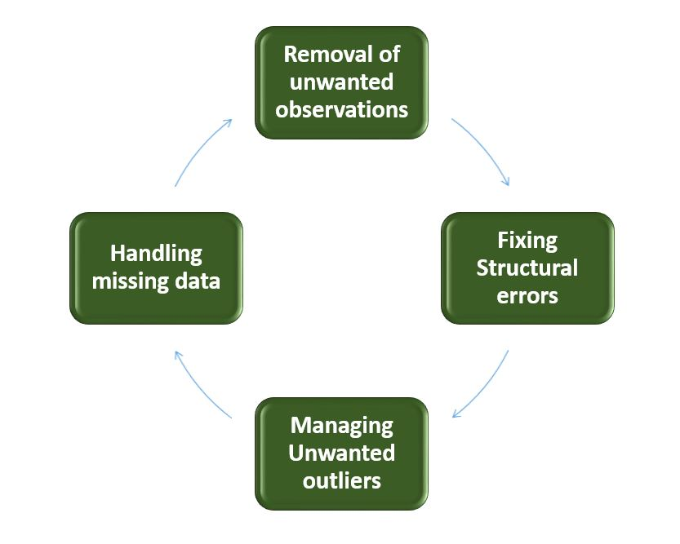
DATA CLEANING
Data cleaning techniques are not only an essential part of the data science process – it’s also the most time-consuming part. “Data scientists spend 80% of their time cleaning and manipulating data and only 20% of their time actually analyzing it.”
Data cleansing is the process of detecting and correcting inaccurate records from a database and refers to identifying incomplete parts of the data and
dealing with it.
STEPS INVOLVED IN DATA CLEANING:
1)Remove unwanted data .2)Fix structural errors 3)Filter unwanted outliers 4)Handle missing data
.

Slide 6
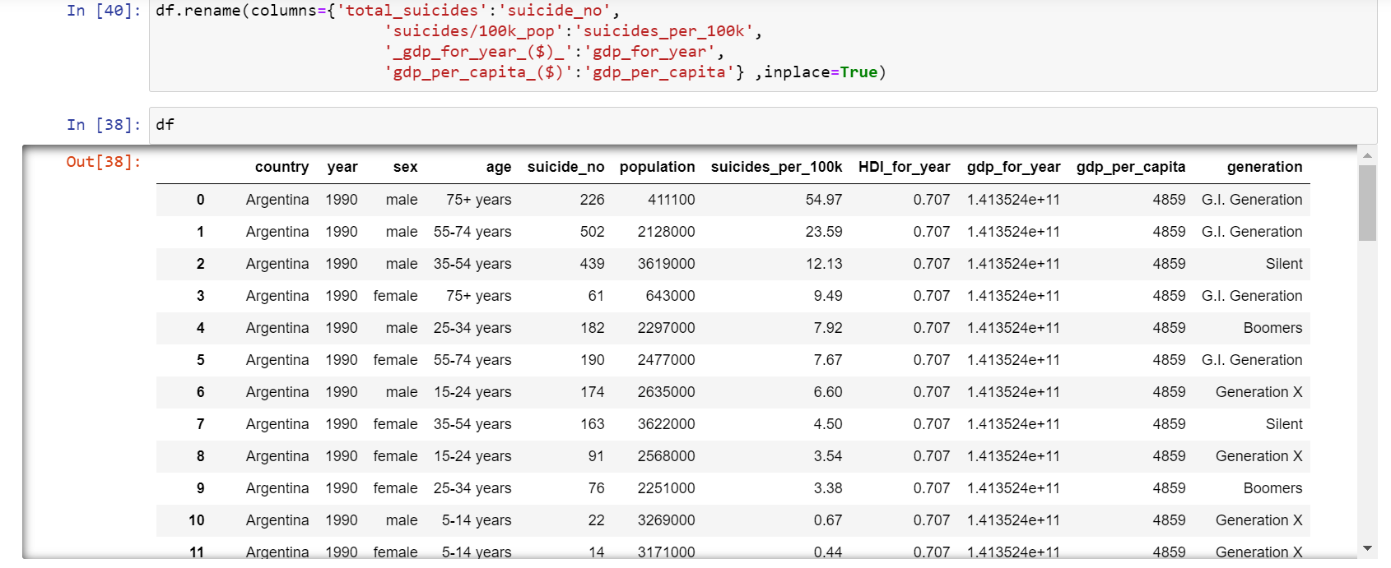
DATA CLEANING WITH RESPECT TO OUR DATASET
In this data set, we renamed the columns because it was not in a proper format i.e, not consistent.

Slide 7
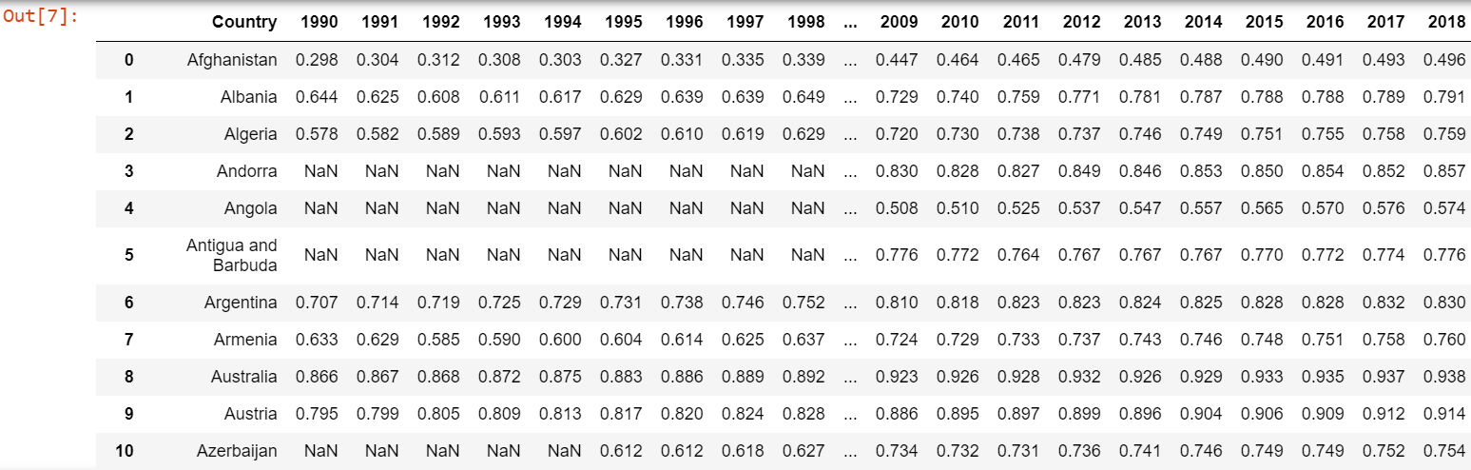
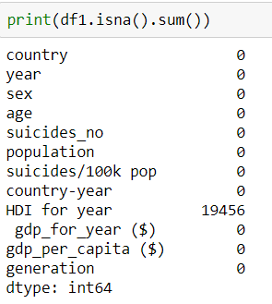
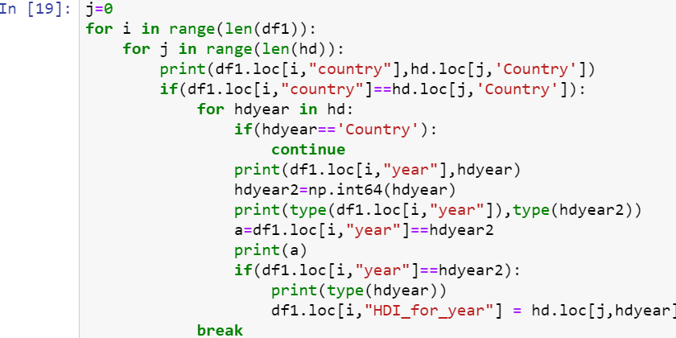
Our data consists of 19456 null values in the HDI column.
The dataset is taken from the UNDP website,which has HDI for all the years,we imputed the values from this into the HDI column of our data set to fill the null values.The code for imputing is shown.

Slide 8
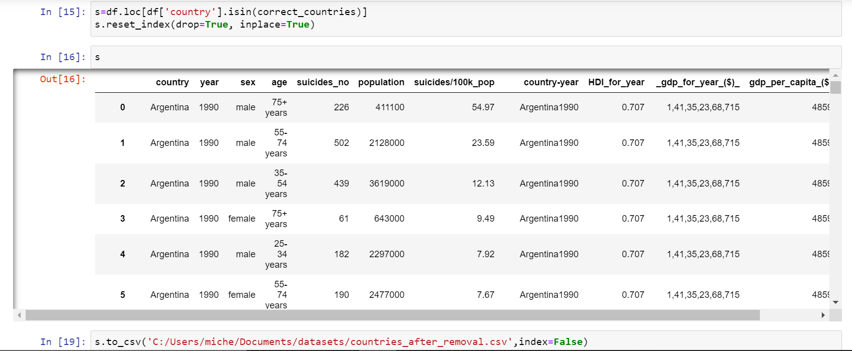
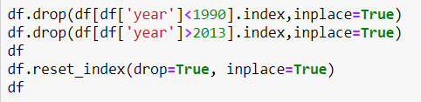
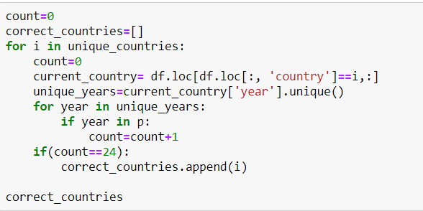
The original data consisted about 101 countries,from 1985-2016. But not all countries had data for all the years, so we removed the countries which which didn’t have all the countries from 1990-2013. So at the end 40 countries passed this criteria.

Slide 9
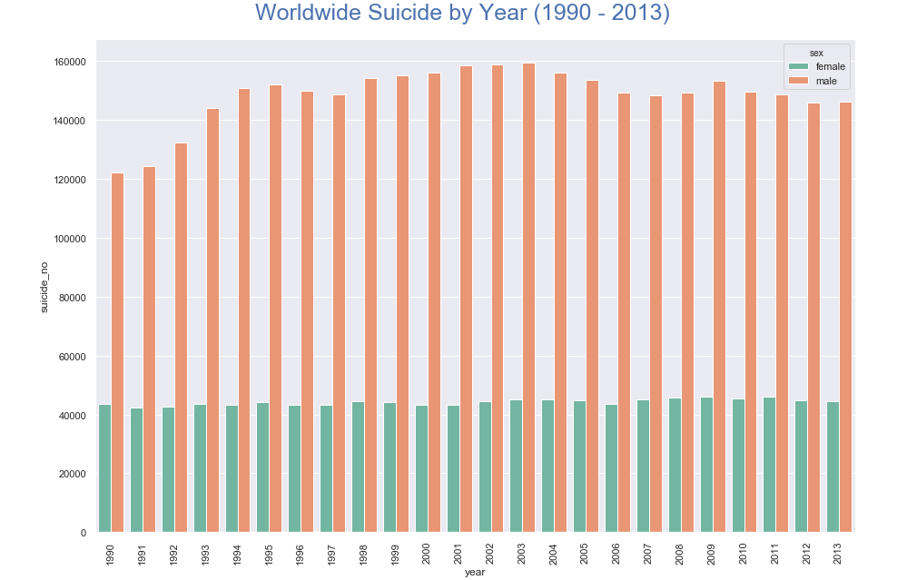
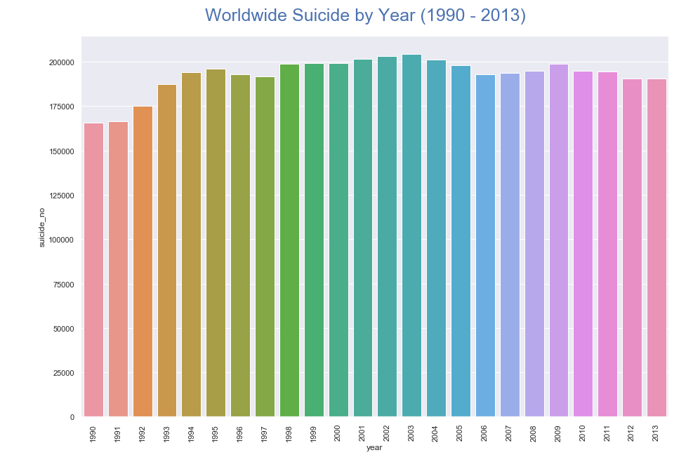
Bar graph: year vs suicide number
X-axis: Year
Y-axis: Suicide number
Bar graph: year vs suicide number
X-axis: Year
Y-axis: Suicide number(total number of suicides)
.

Slide 10
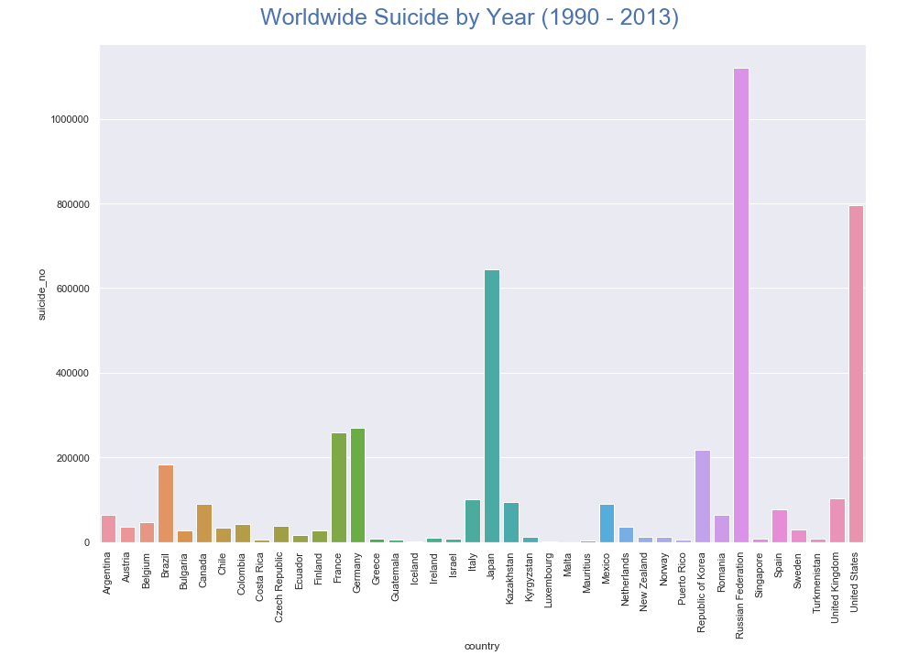
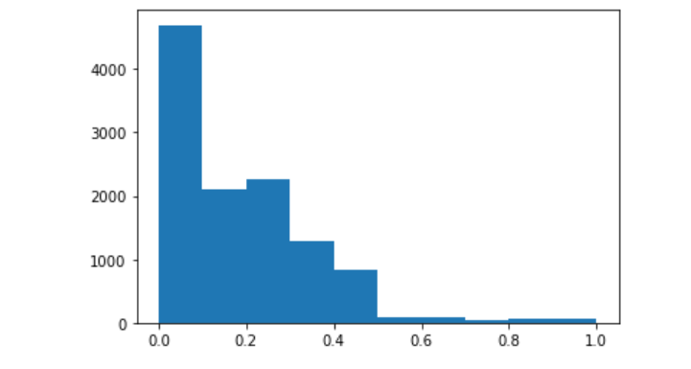
3. Bar graph : Country vs suicide number
X-axis: Country
Y-axis: Suicide number(total number of suicides)
4. Histogram: GDP per capita
The histogram is plotted for GDP per capita for the different countries.
The skew factor is 1.472
There are more than 4000 values that have values that have GDP per capita between 0 to 0.1
.

Slide 11
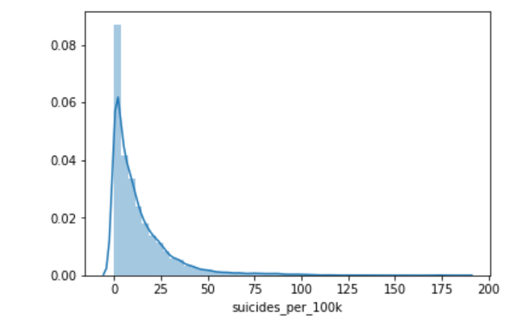
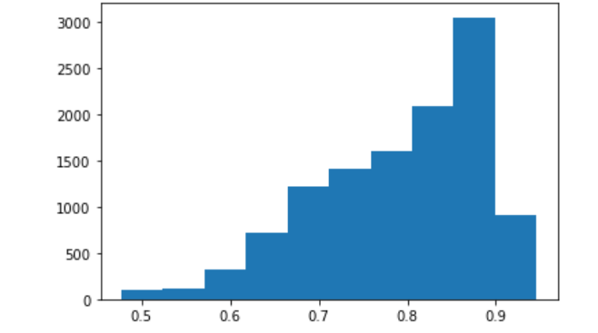
5. Histogram: suicides per 100k
The histogram is for suicides per 100k
The highest number of suicides per 100k lies between 0 to 25.
6. Histogram: HDI for year (for different countries)
The histogram is for HDI for year
Most countries have HDI for year between 0.8
and 0.9

Slide 12
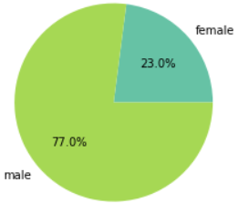
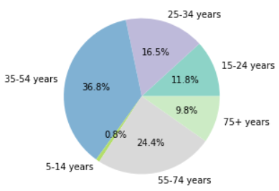
7. Pie Chart: Suicide rates in males and females
Suicide rates amogst males is greater than females.
8. Pie Chart: Suicide rates in different age groups
Suicide rates are maximum in the age group of 35-45 years, followed by 55-74 years.

Slide 13
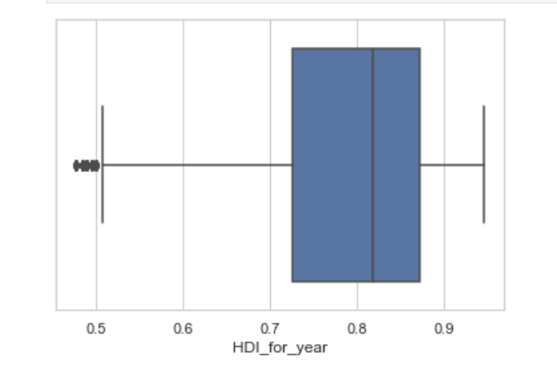
9. Box Plot- HDI for a year:
HDI for a year has a minimum value of 0.5. HDI for a year has a maximum value of approximately 0.95.
The median for our data is approximately 0.8

Slide 14
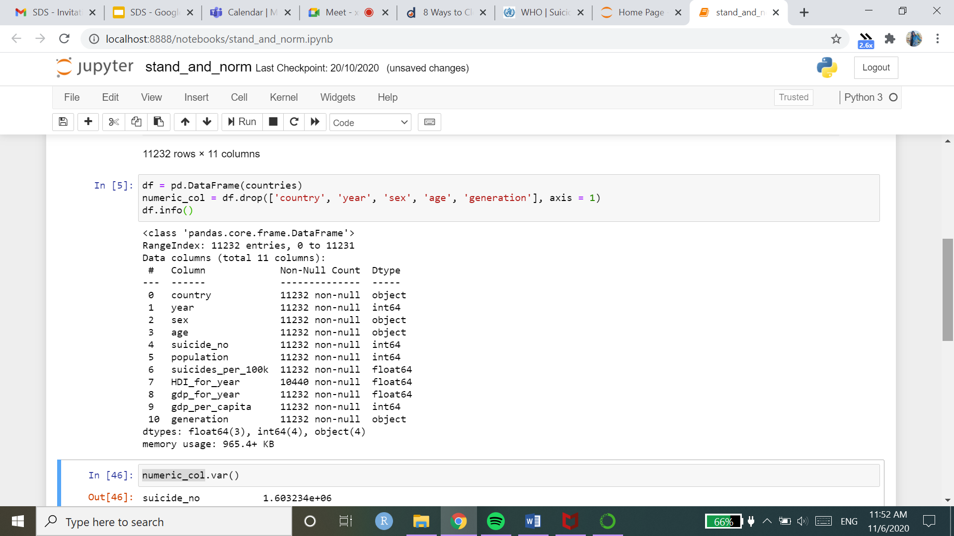
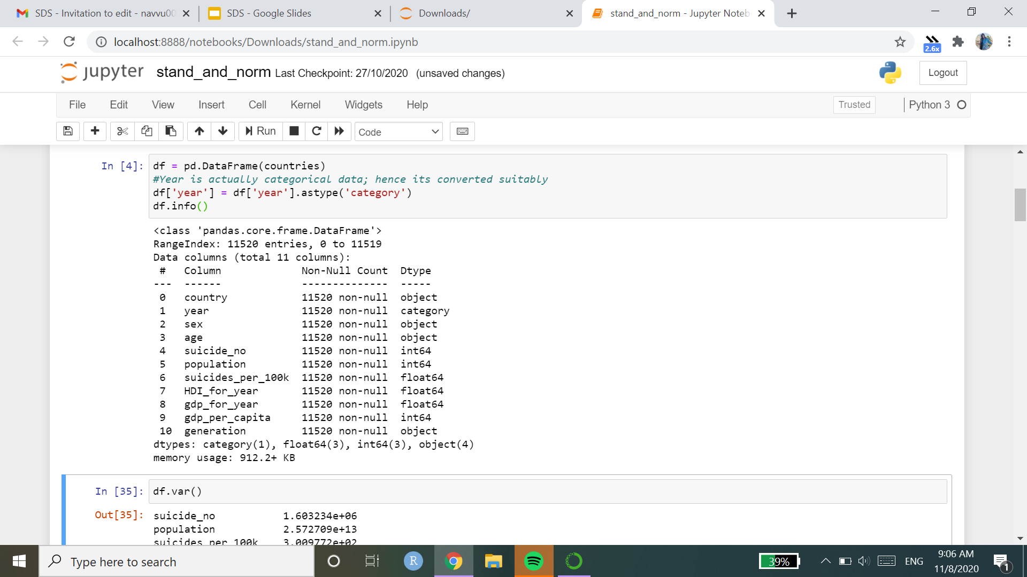
STANDARDISATION AND NORMALISATION
Converting the columns into suitable data types

Slide 15
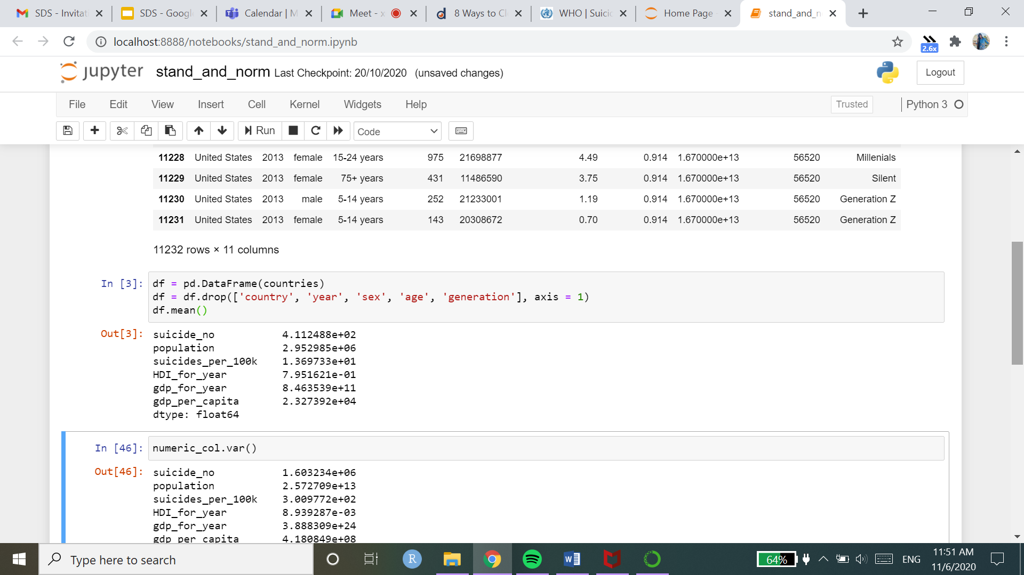
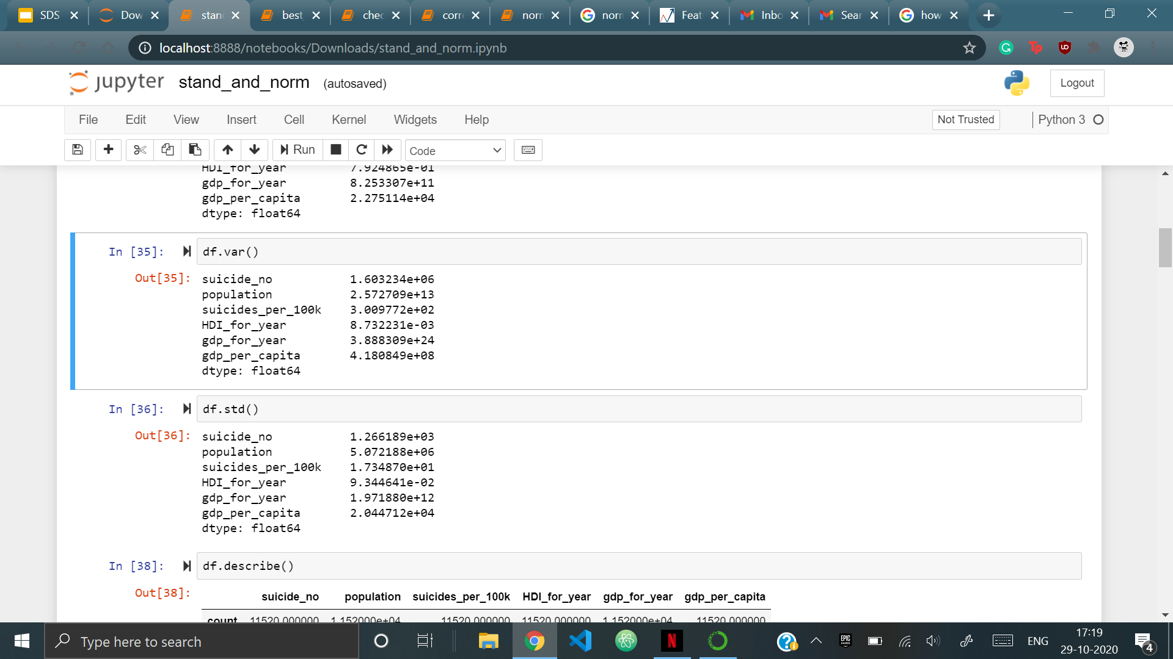
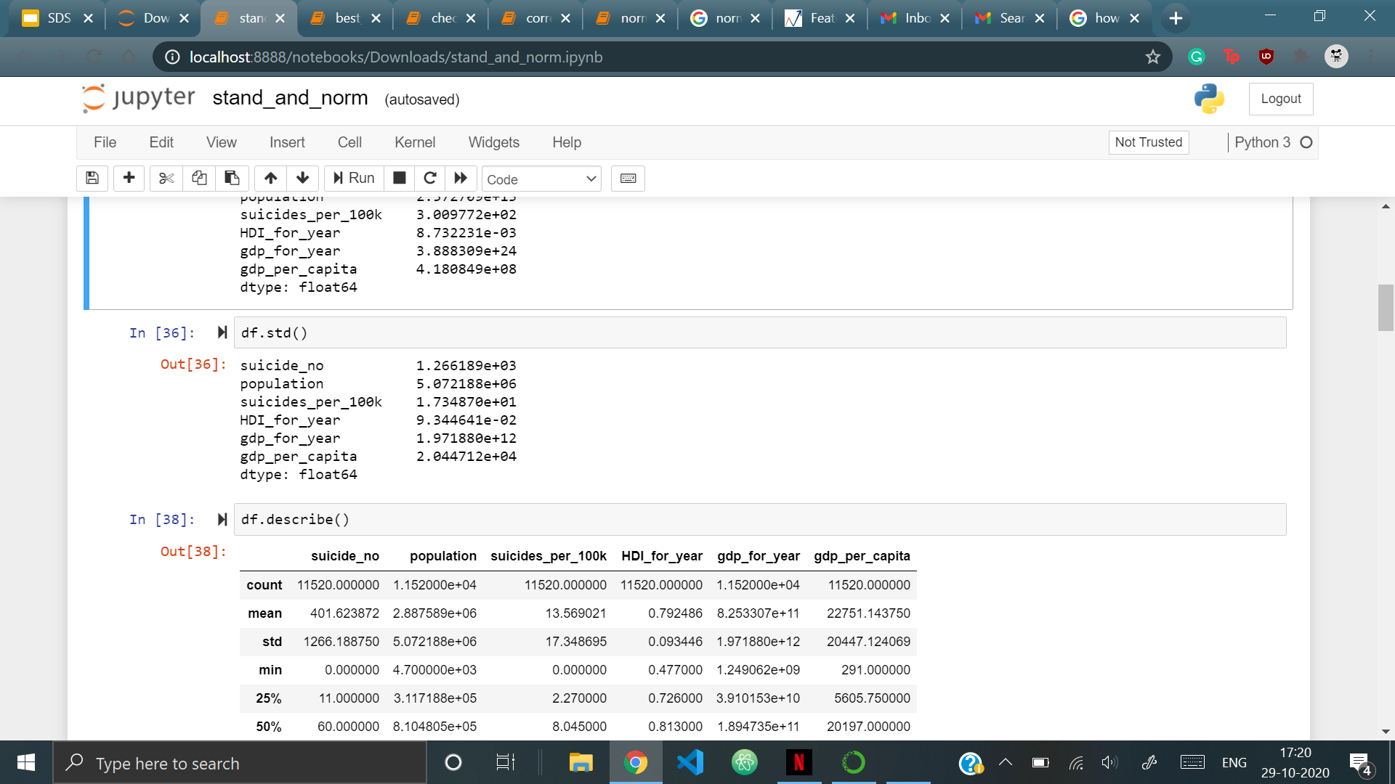
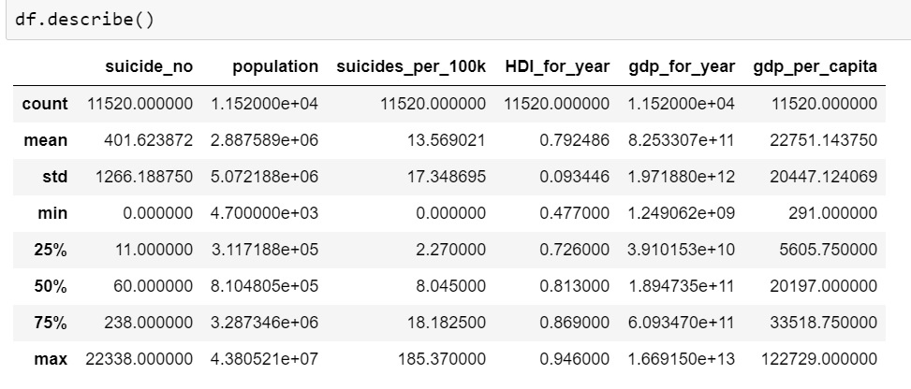
STANDARDISATION AND NORMALISATION
Population Parameters:

Slide 16
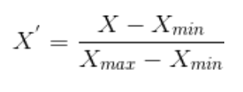
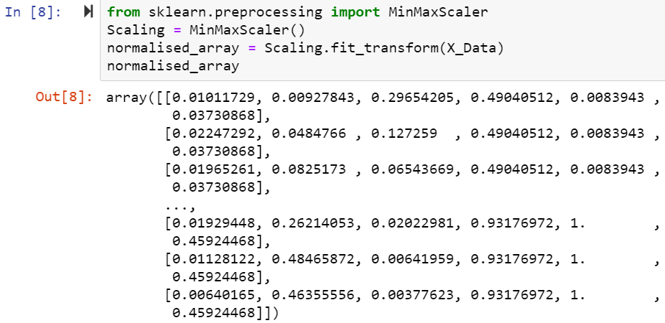
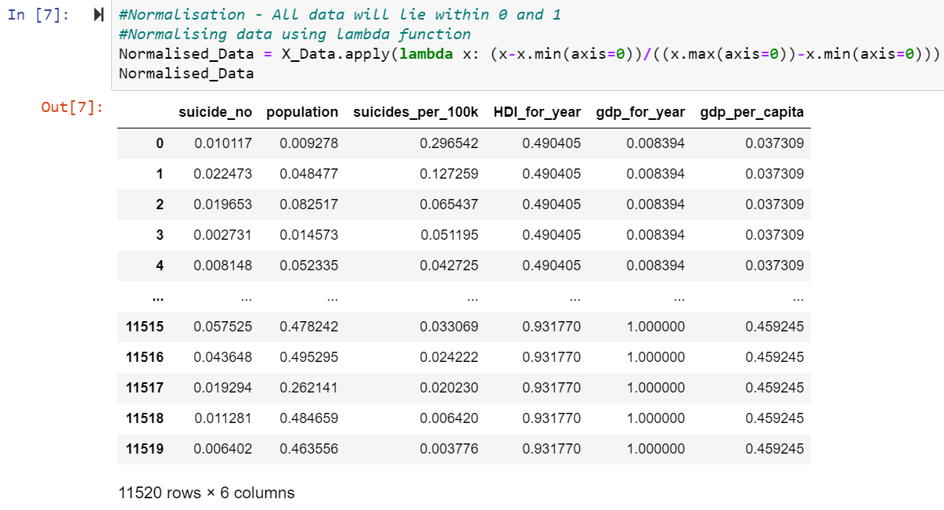
NORMALISATION
Database normalization is the process of structuring a relational database in accordance with a series of so-called normal forms in order to reduce data redundancy and improve data integrity. Data can be normalized in two ways:
(i) using lambda function (ii) using MinMaxScaler function

Slide 17
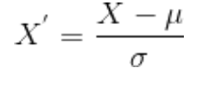
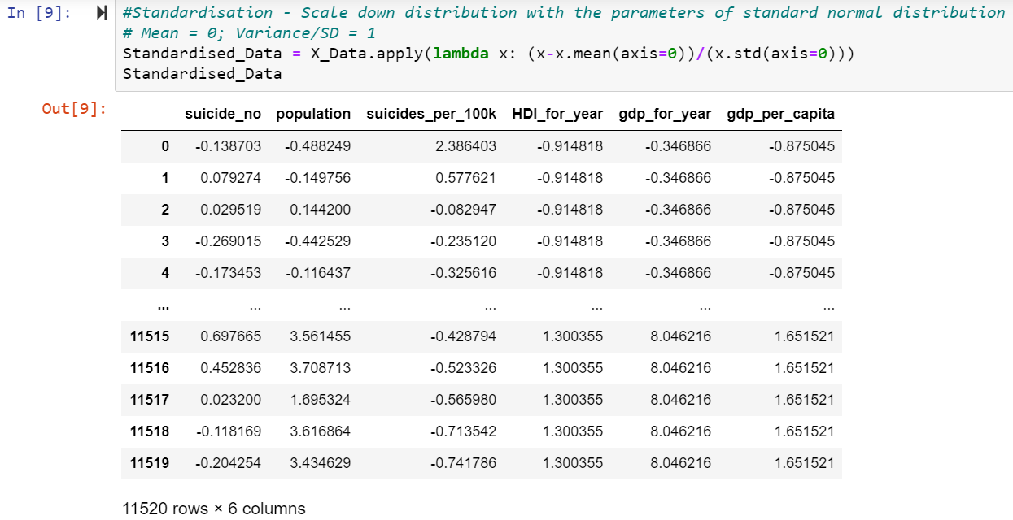
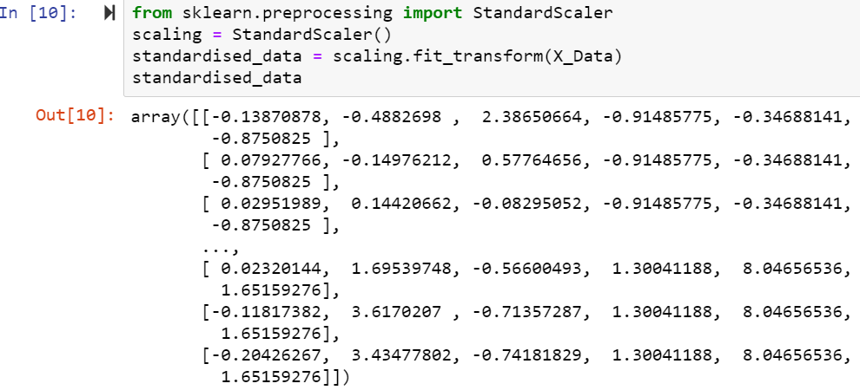
STANDARDISATION
Standardization is another scaling technique where the values are centered around the mean with a unit standard deviation. This means that the mean of the attribute becomes zero and the resultant distribution has a unit standard deviation.
i) Using lambda function (ii) Using StandardScaler function

Slide 18
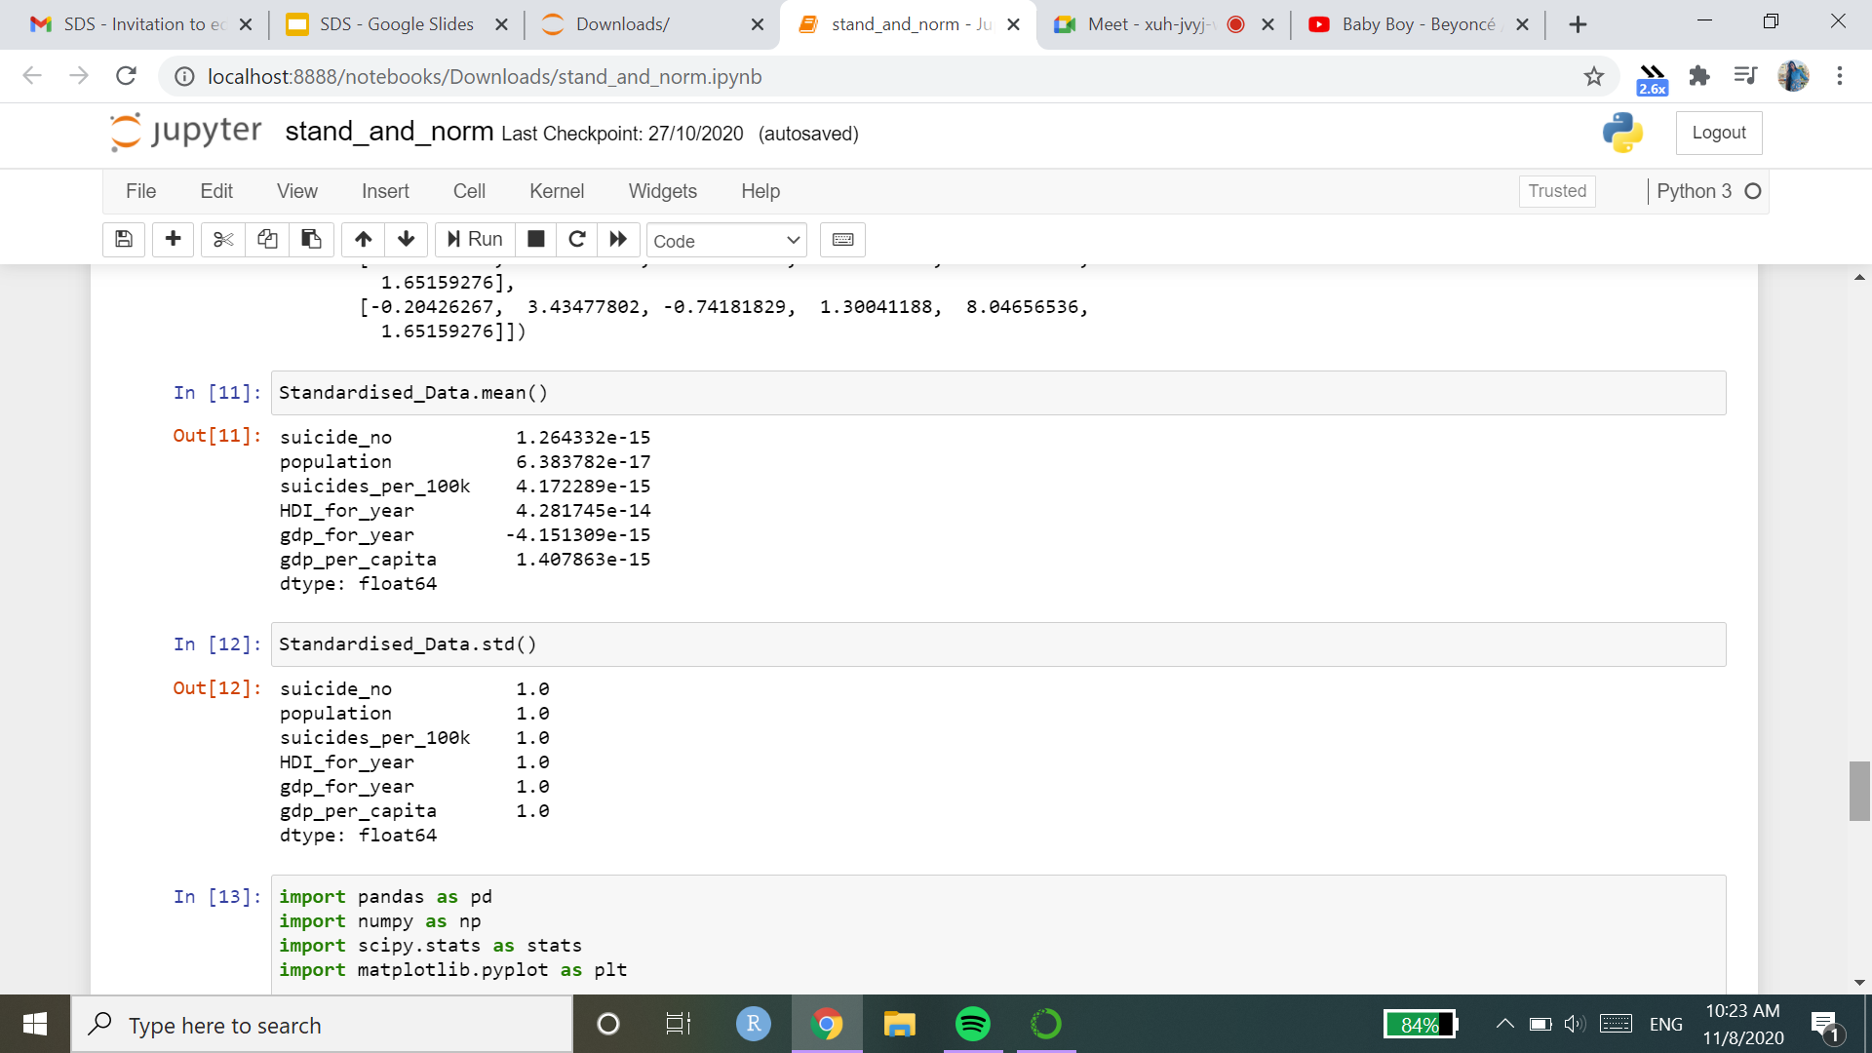


Slide 19
WHY NORMALISE AND STANDARDISE?
The variables in the data may have different ranges and different units.
Some variables may outweigh the others during analysis.
Hence, we equalise range and data variability.
One variable should not influence the analysis more than another variable

Slide 20
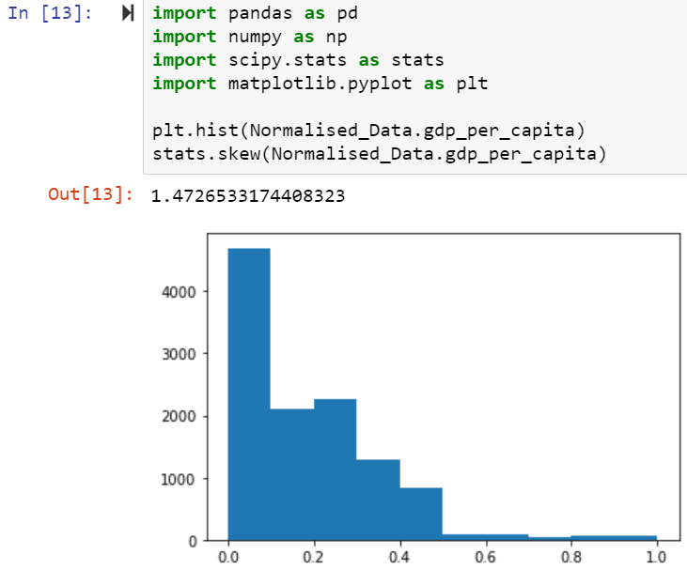
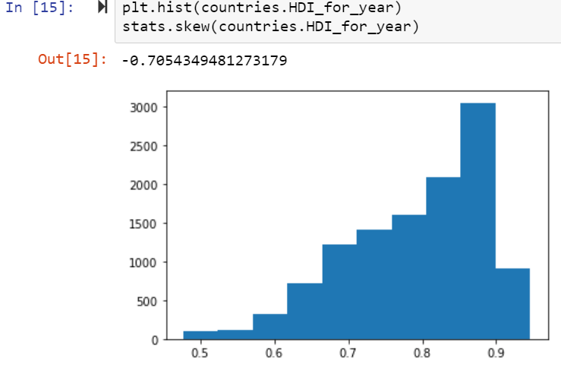
Answering the question of whether or not any data is normal, none of the data of any column in our dataset is normal.
The histogram for gdp per capita, is right skewed with a skew factor of 1.47.
The histogram for HDI for year, is left skewed with a skew factor of -0.70.

Slide 21
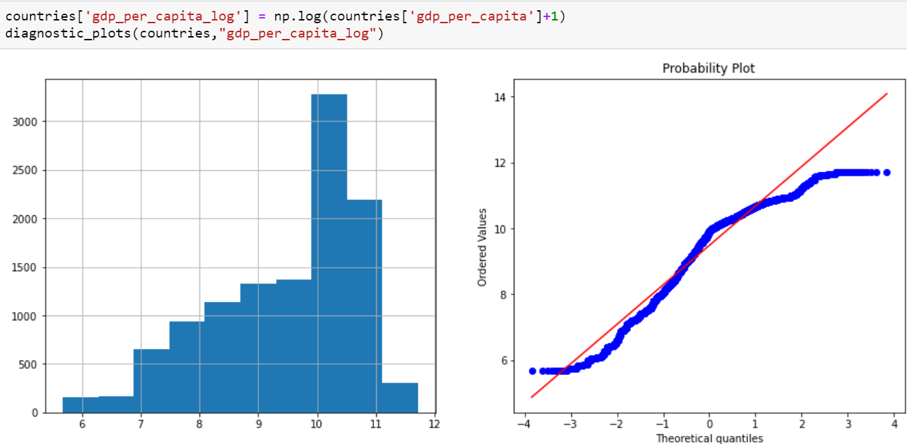
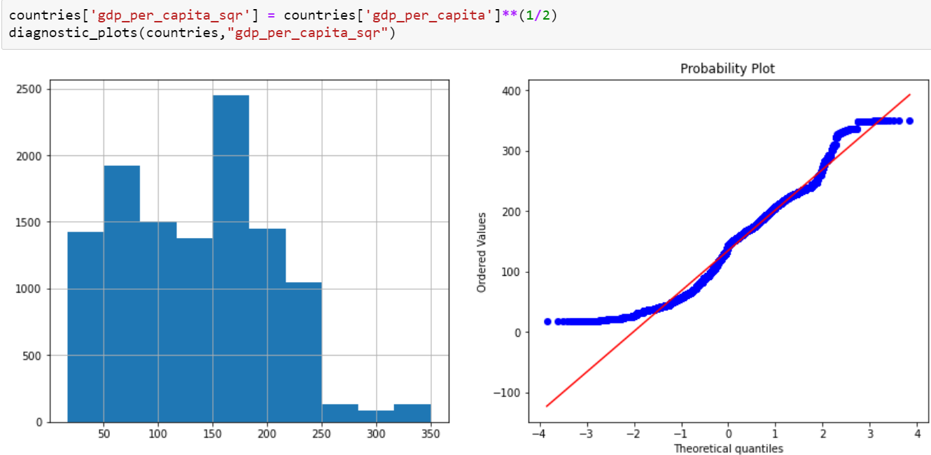
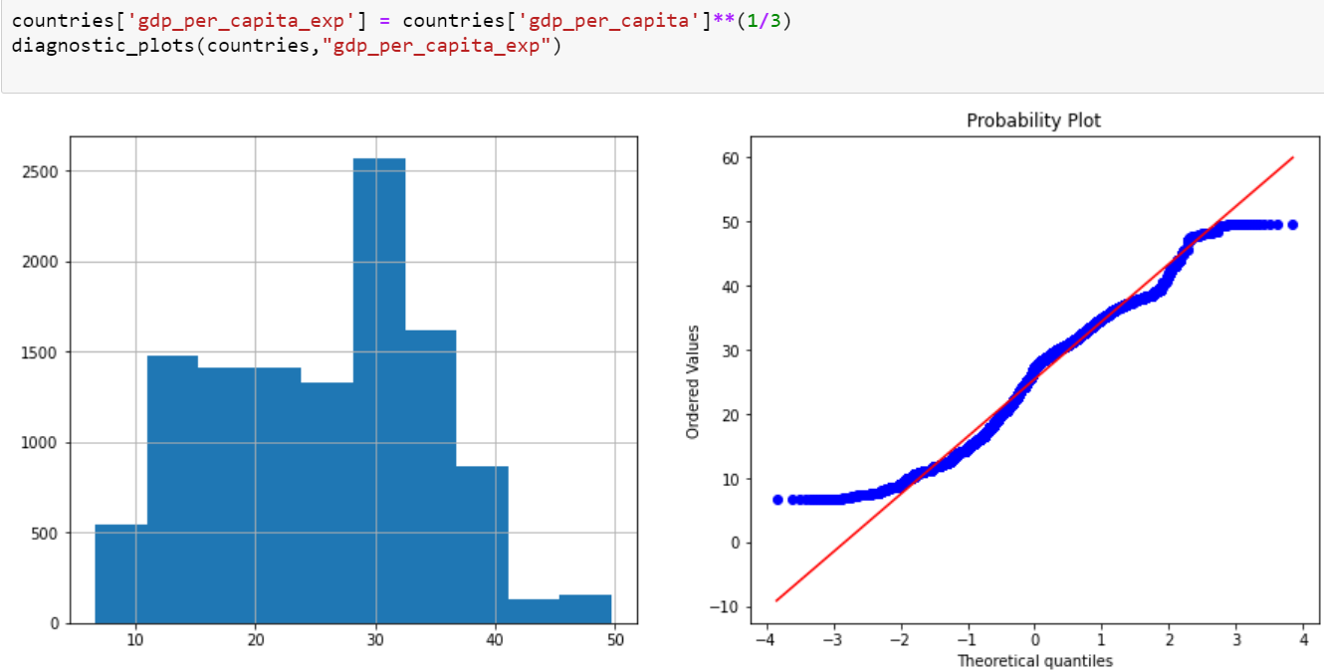
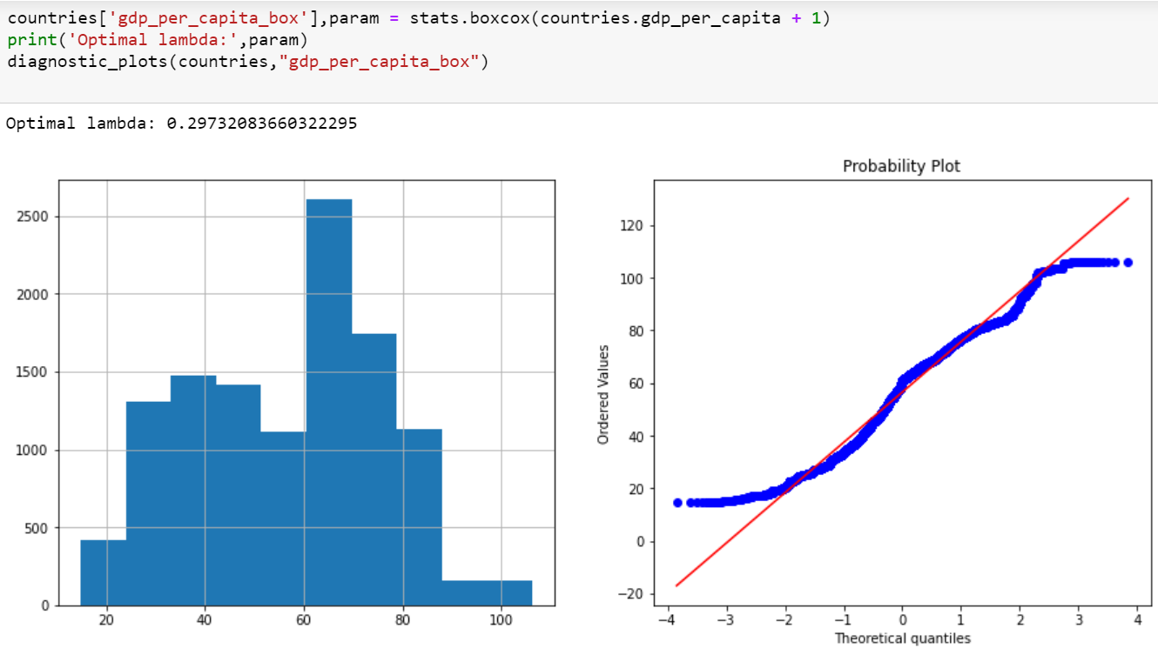
None of our data in any of the columns in our dataset is normal, hence we tried normalizing the data. Data can be normalized using several methods.
(i) Logarithmic transformation (ii) Square transformation
(iii)Exponential transformation
(iv)Box transformation

Slide 22
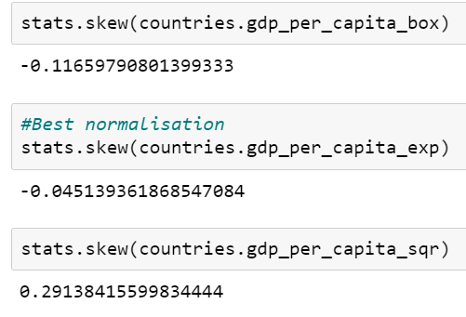
SKEW OF THE DATA
Skew factors of the previously mentioned transformation methods:
As we can see, the exponential transformation yields the lowest skew factor and is hence the best method to normalize the data, for this particular variable which is GDP per capita.

Slide 23
HYPOTHESIS TESTING
Research Hypothesis 1:
A set of countries whose HDI was greater than 0.801325 wanted to prove that their mean suicides_per_100k in 2003 would be lesser than the population mean suicides_per_100k. ie. 12.588647(2.368484- logged value)
#H0:The total suicides_per_100k is 𝝁 >= 2.368484
#H1:The total suicides_per_100k is 𝝁 < 2.368484
Assuming H0 is true
We perform a one sample t test, left tailed

Slide 24
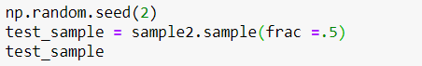
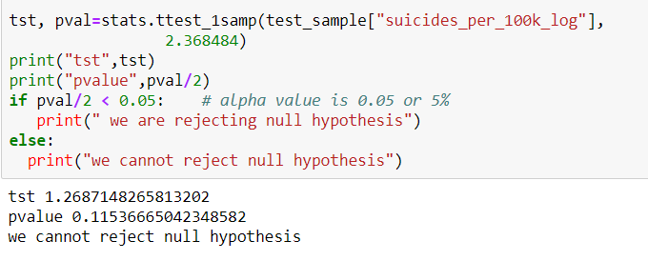
p=0.115
We fail to reject H0 as p>0.05.
H0 is plausible
Conclusion: There is not sufficient evidence to support the claim that the total_suicides_per_100k will be lesser than 12.588647 if the HDI is greater than 0.801325
Notes:
Scipy.stats-package

Slide 25
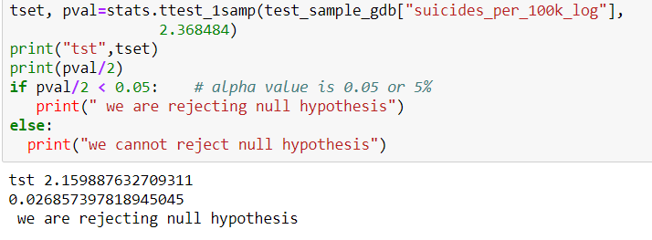
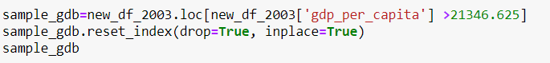
Research Hypothesis 2:
A set of countries whose GDP was greater than 21346.625 wanted to prove that their mean suicides_per_100k in 2003 would be lesser than the population mean suicides_per_100k ie. 12.588647(2.368484- logged value)
#H0:The total suicides_per_100k is 𝝁 >=2.368484
#H1:The total suicides_per_100k is 𝝁 < 2.368484

Slide 26
p=0.027
We reject H0 as p<0.05 and accept alternate hypothesis
Our results are statistically significant at 5% level
Conclusion: There is some evidence that total_suicides_per_100k will be lesser than 12.588647 if the GDP is greater than 21346.625

Slide 27
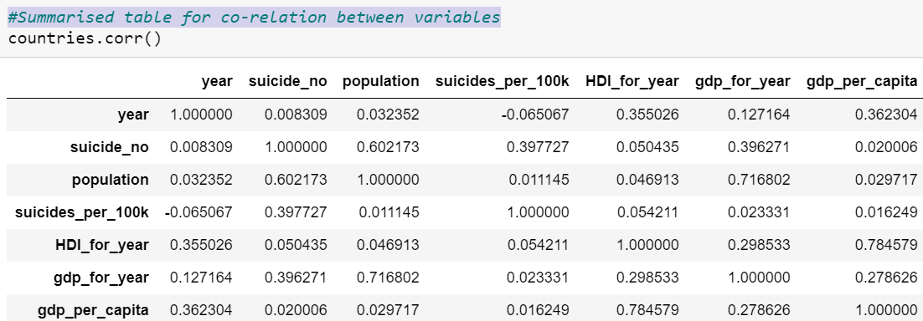
CORRELATION
We can’t find correlation between any two variables if missing values are present, so we must take care of this before starting to work on correlation.
Correlation or dependence is any statistical relationship, whether causal or not, between two random variables or bivariate data. In the broadest sense correlation is any statistical association, though it commonly refers to the degree to which a pair of variables are linearly related.

Slide 28
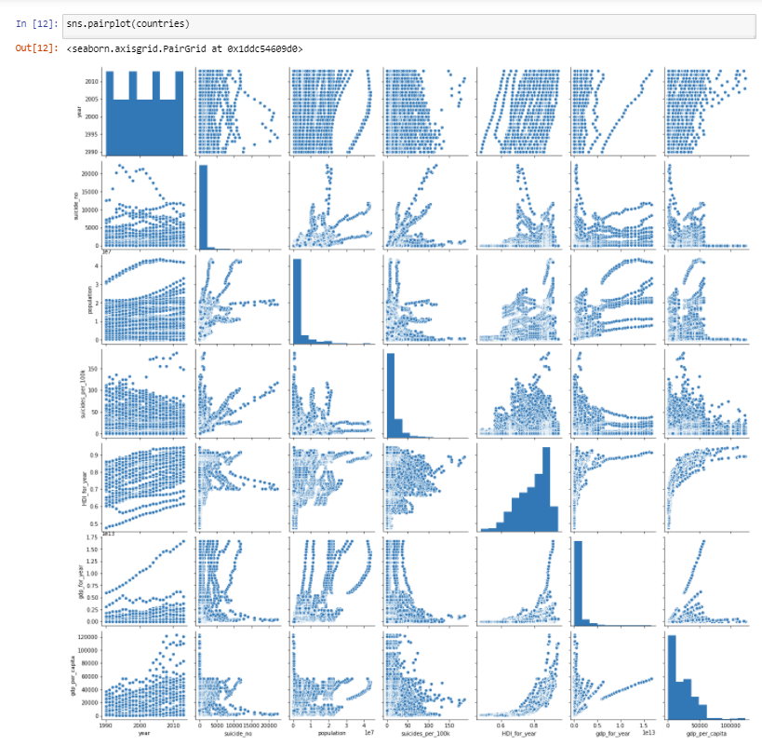
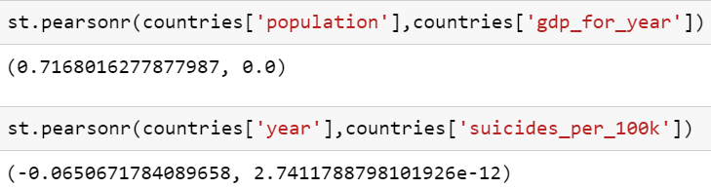
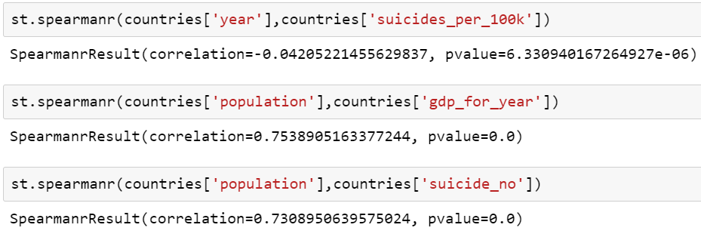
WAYS TO FIND CORRELATION:
(i) pearson correlation
(ii) spearman correlation

Slide 29
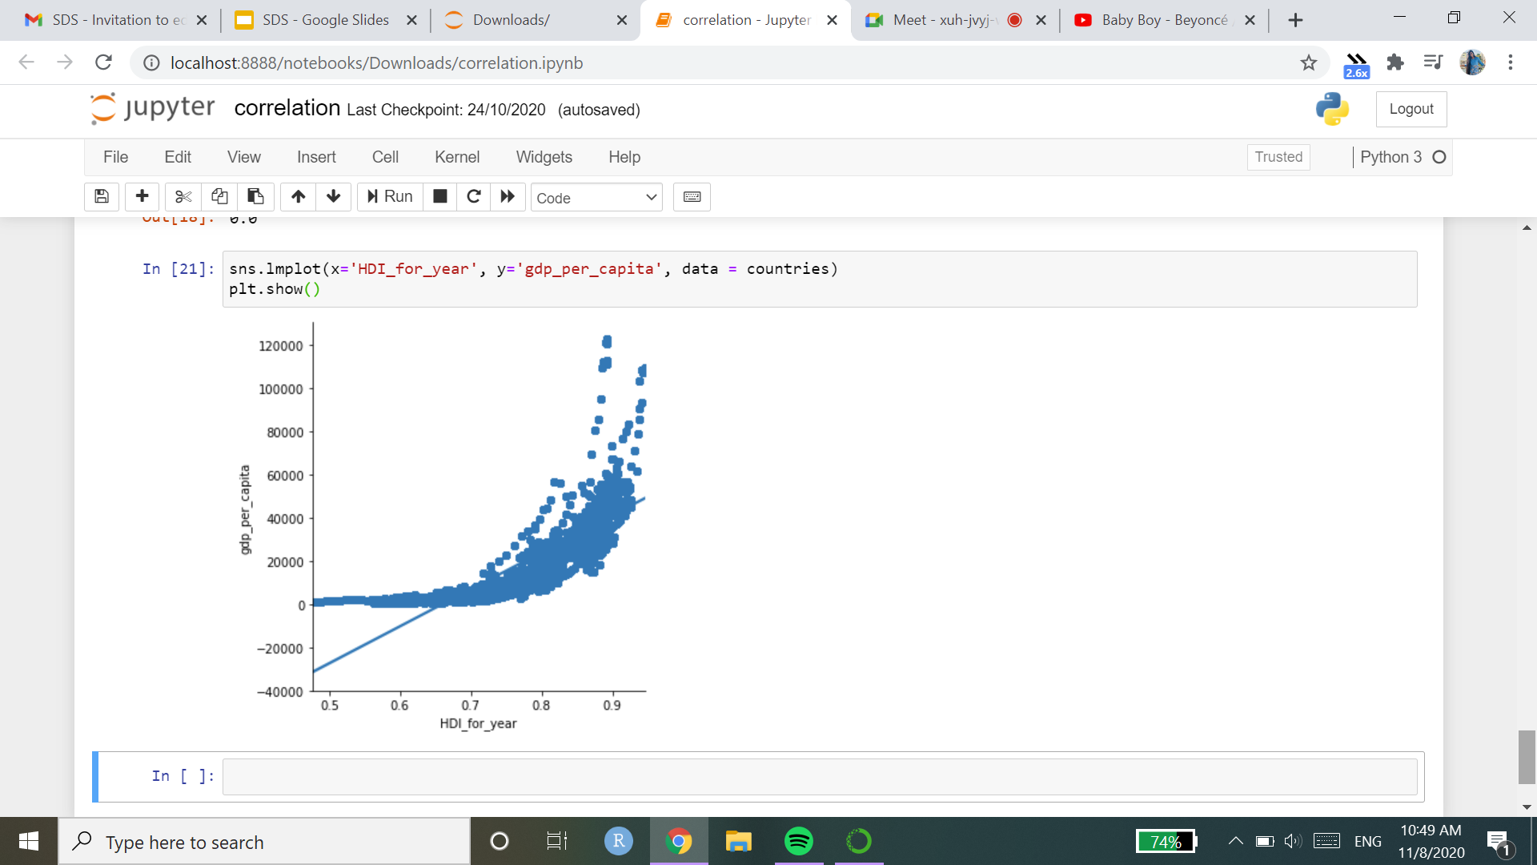
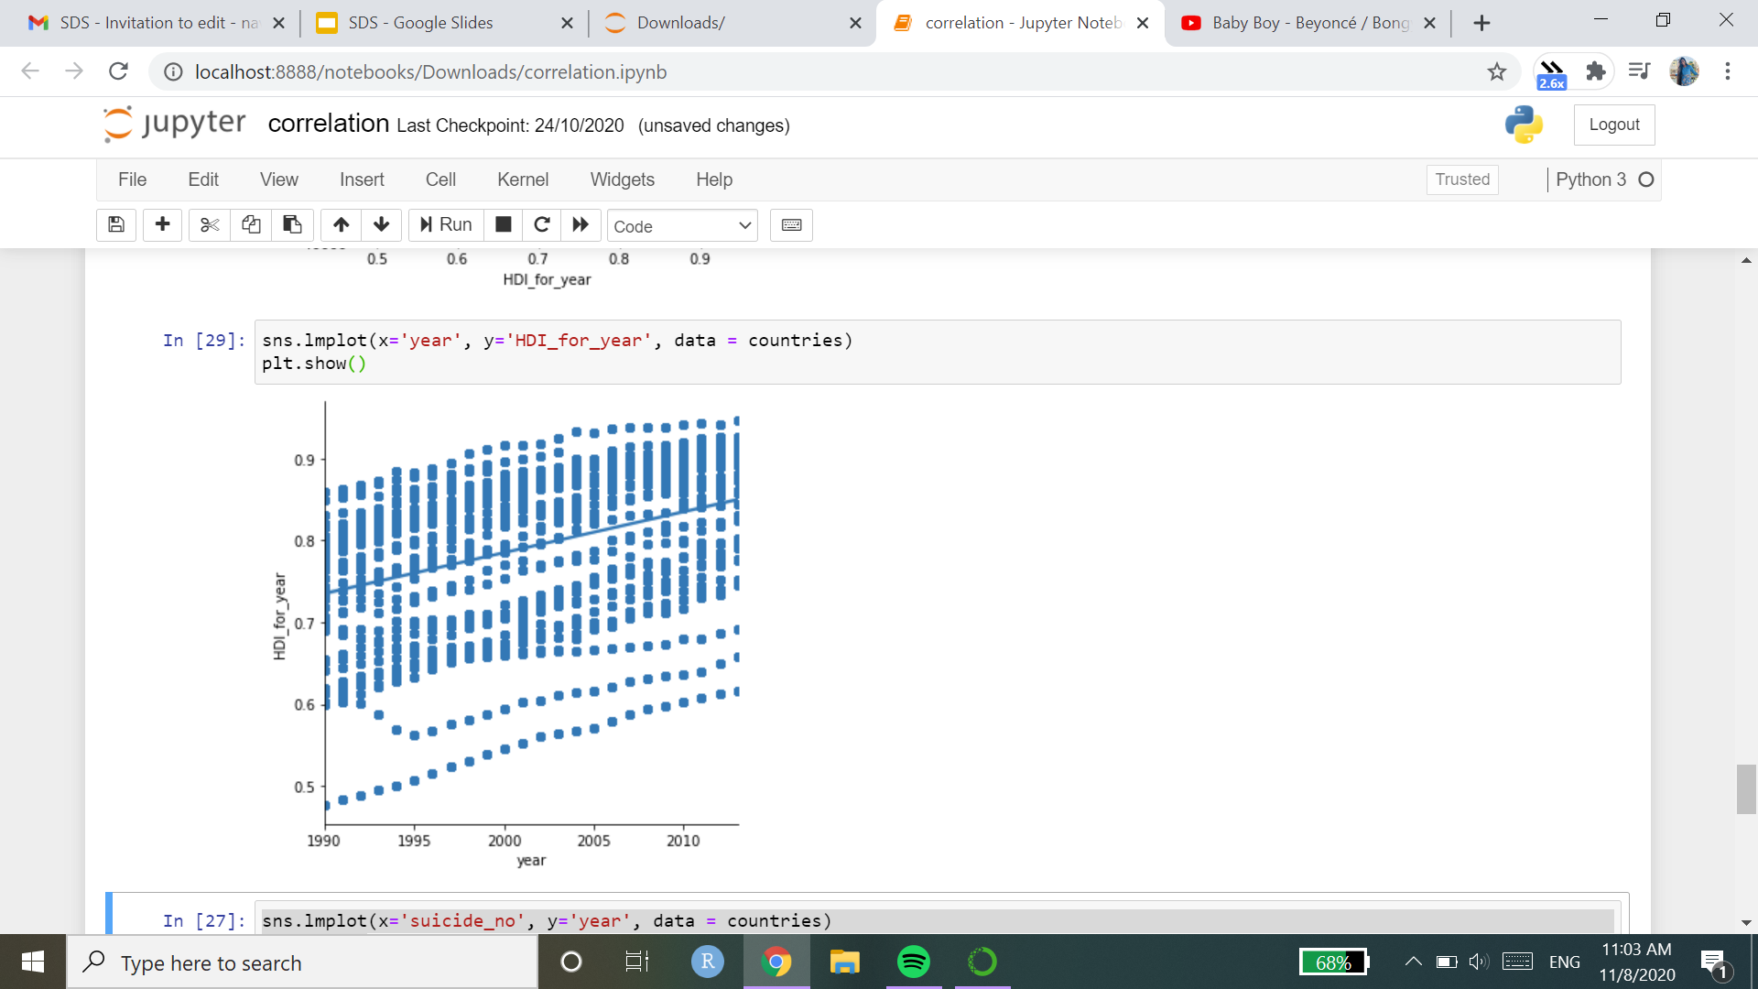
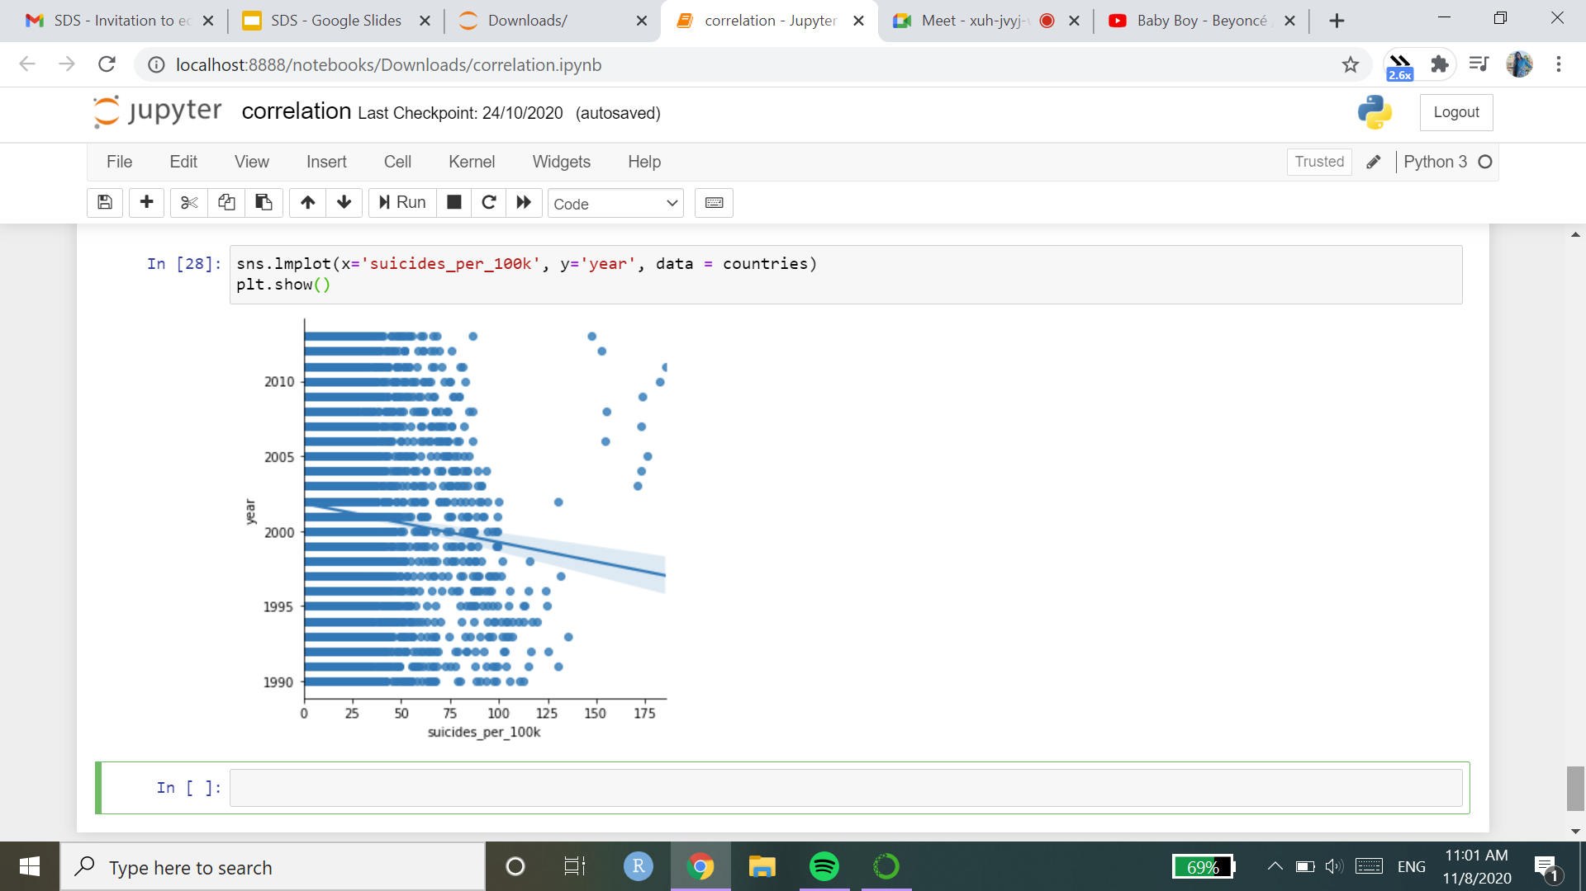
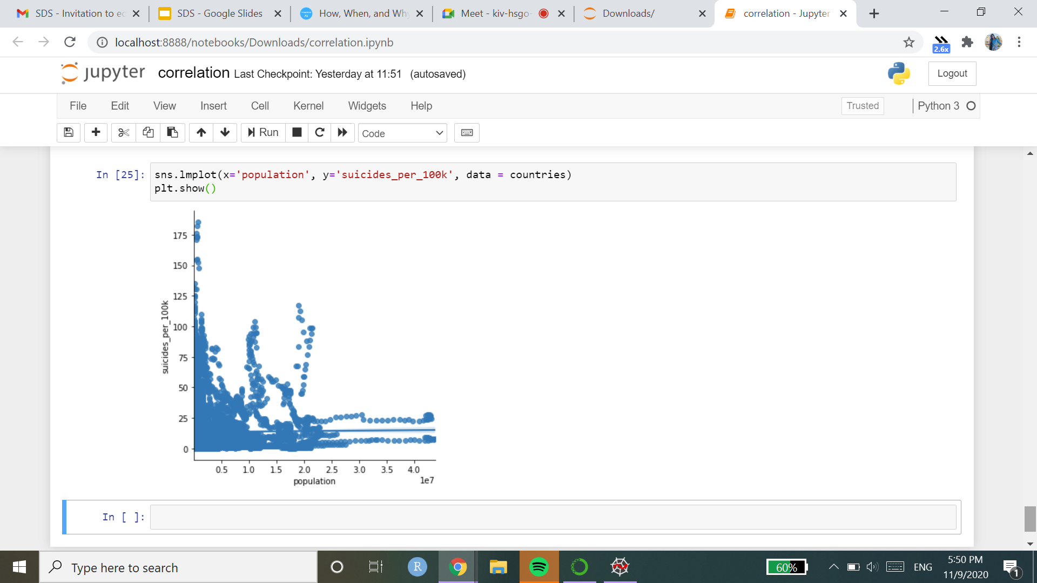
iii) Using graphs
Positively correlated
Negatively correlated No correlation

Slide 30

COVARIANCE
Covariance is a statistical tool that is used to determine the relationship between the movement of two variables.

Slide 31

HEATMAP
A heat map is a data visualization technique that shows magnitude of a phenomenon as color in two dimensions. The variation in color may be by hue or intensity, giving obvious visual cues to the reader about how the phenomenon is clustered or varies over space.

Slide 32
RESULT AND CONCLUSION
Suicides were maximum in the age group of 35-54.
Suicides were greater amongst males than females.
Suicide rates were highest in Russia.
In our hypothesis testing, we found that :
There is not sufficient evidence to support the claim that the suicides per 100k, will be lesser than the mean suicides per 100k, if the HDI is greater than 0.801325.
There is some evidence that total_suicides_per_100k will be lesser than the mean suicides per 100k if the GDP is greater than 21346.625
The variables, GDP per capita and HDI for year, and year and HDI for year are positively correlated.

